Slide 1
Principles of Programming Language
Amit Dua
Computer Science and Information Systems Department
BITS, Pilani

Slide 2
Introduction Unix Operating System
Tutorial 1

Slide 3
Topics
Execution of C program with example
Kernel

Slide 4
What Is Operating System ?
An Operating System can be defined as the software that controls the hardware resources of the computer and provides an environment under which programs can run.
Simply
Operating System is an interface between user of a system and the computer hardware.

Slide 5
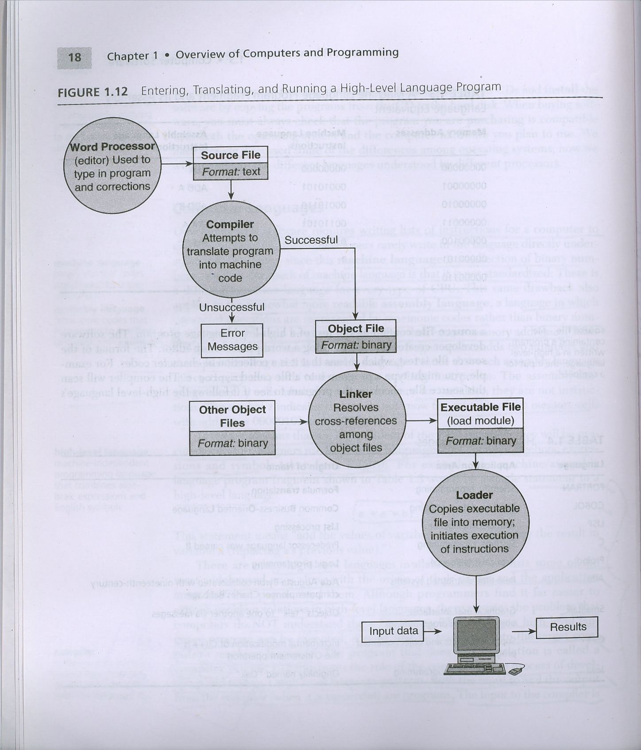
Execution Process of a Program
#include<stdio.h>
int main(void)
{
printf("Hello World\n");
return(0);
}
Hello.c
ELF??????????????????????ô???????4?????(? ??L$ƒäðÿqüU‰åQƒìÇ$????èüÿÿÿƒÄY]aüÃ??Hell
gcc -c Hello.c
Hello.o
gcc –o exe Hello.o
./exe

Slide 6
Operating System Services
Loading Programs into the memory
Memory Management
Linking Libraries
Execution of Programs
Handling disk I/O request
Handling peripheral device request
Handling multiple program execution
Communication between the processes etc

Slide 7
What is Unix?
Unix is a
Multi-programming
Multi-tasking /Time Shared
Multi-user Operating System

Slide 8
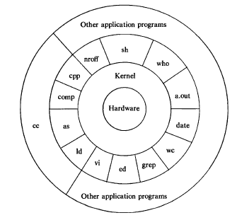
Layered architecture of the UNIX OS

Slide 9
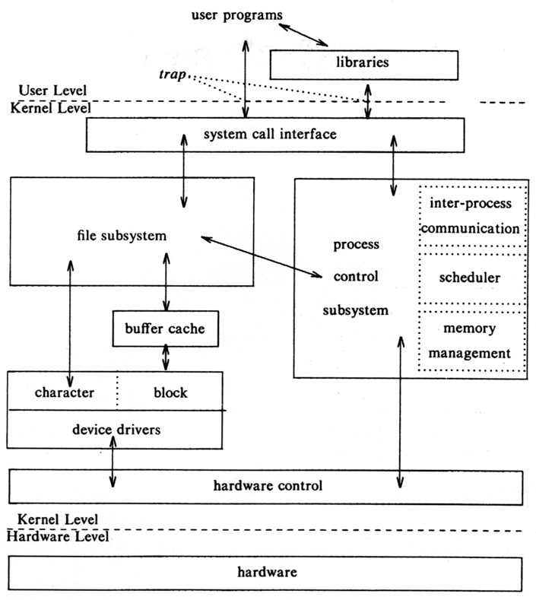
Block Diagram of System Kernel

Slide 10
Kernel (It’s a heart of OS)
Kernel is a program that constitutes the central core of the Operating System.
Kernel provides basic services to all other parts of the Operating System including
Process Management: Process creation, termination, scheduling, execution etc
Memory Management: Allocation of memory to a program for execution
File Management : Creation of files, managing file permissions etc
I/O Management : Allocation of I/O devices
Network Management
It can not directly interact with the user.
But the interaction is done with the help of System Calls
These services are requested by other parts of OS or by the application program through a set of program interfaces called as System Calls.

Slide 11
System Call
It’s an interface with which a user application or any other part of OS request the kernel to provide services.
Since user can not directly access the kernel, It can access it through system calls.
There are many system calls for different types of services provided by the OS.
For example,
File Management system calls – open(),read(),write(), close().
Process Management – fork(), exec()

Slide 12
Shell
Shell is an interface between user and the kernel.
It primary function is to read commands from the console and execute them.
The term Shell comes from the fact that it is the outer most part of the OS.
Several shells like Bourne, Korn, Bourne-again, C Shell are available.

Slide 13
C Library Function Calls and System Calls
Functions defined in different C library are used in C program.
These functions internally invoke system calls to get the service from the kernel.
C library function call can not directly invoke the functionalities in kernel.
User application can directly invoke system call or through C library function.
For example, printf() in turn calls a write() system call to print a string to stdout.

Slide 14
C Library Function Calls and System Calls
malloc() in C is a library function in <stdlib> which is used to allocate memory. This in turn invokes a system call sbrk() which increases or decreases the address space of the process by the specified number of bytes.
System calls like fork(), exec() can be directly invoked by the program.

Slide 15
Program Execution Process (exec() system call)
An executable of a program is executed with the help of a system call exec().
This system call loads the text and data of a program into the memory before execution.
This system call takes the name of the executable along with command line arguments as input parameter and invokes the main() function of the program.

Slide 16
System Programs
System Programs are the programs that give service to other programs and interact with the hardware.
Examples
Operating System – Set of system programs
Compiler
Assembler
Linker
Loader

Slide 17
Schedule of Operating System Tutorials for the First Semester 2020 - 2021

Slide 18
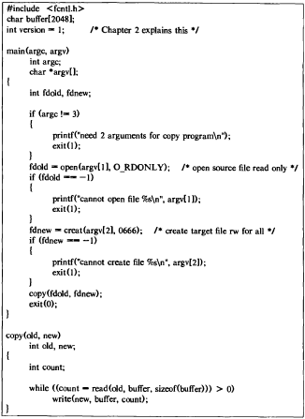
C program

Slide 19
C Program -2
main(argc, argy)
int argc;
char *argv[];
{
/* assume 2 args: source file and target file */
if (fork0 == 0)
execl("copy", "copy", argv[1], argy[2], 0);
wait((int *) 0);
printf("copy done\n");
}

Slide 20
Questions

